Slide 1
Genomic Selection for Drought Tolerance Using Genome-Wide in Cassava

Slide 2
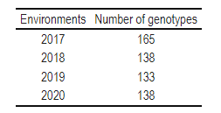
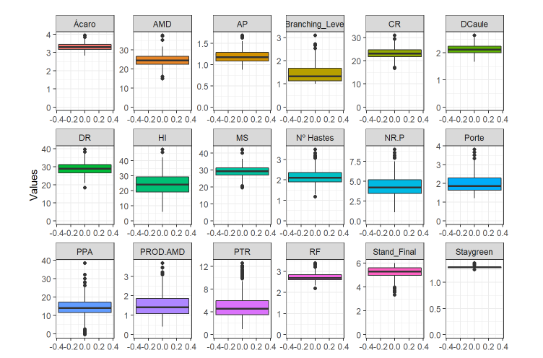
Table 1 – Number of genotypes evalueted by year.
Figure 1 – Boxplot of the BLUPs of the traits evaluated by mixed models in four Years.

Slide 3
Após a MAF e coincidência de clones entre as matrizes
Number of Clones | Number of markers
414 | 27045
414 | 22779

Slide 4
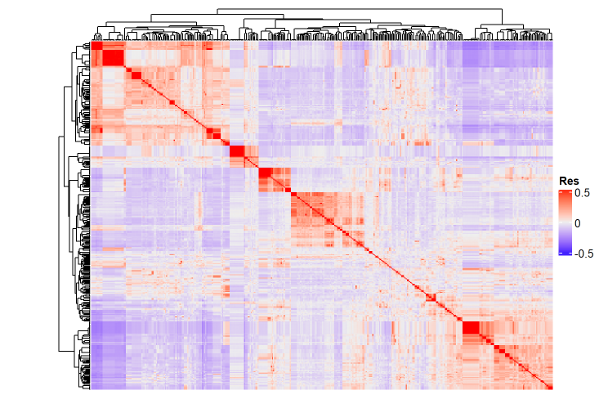
Figure 2 – Heatmap from resemblance between clones obtained by G matrix (414 x 414)

Slide 5
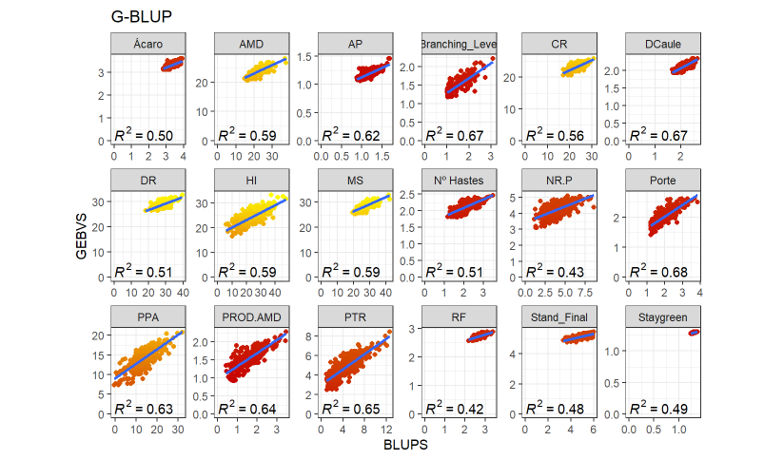
Figure 3 – Correlations between GEBVs by G-BLUP and BLUPs by mixed models for traits evalueted.

Slide 6
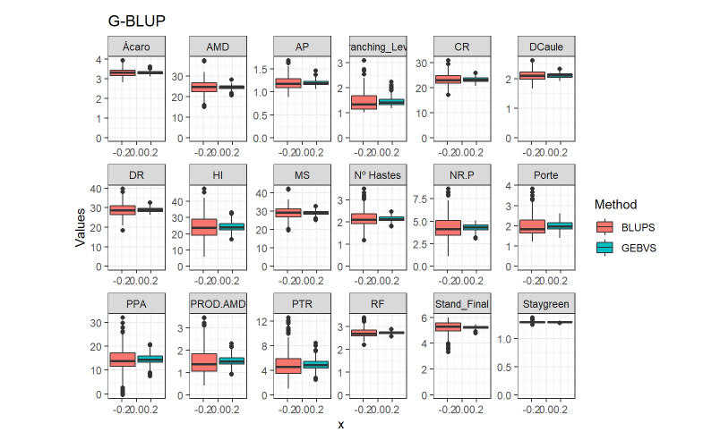
Figure 4 – Boxplot between GEBVs by G-BLUP and BLUPs by mixed models added to phenotypic means for traits evalueted.

Slide 7
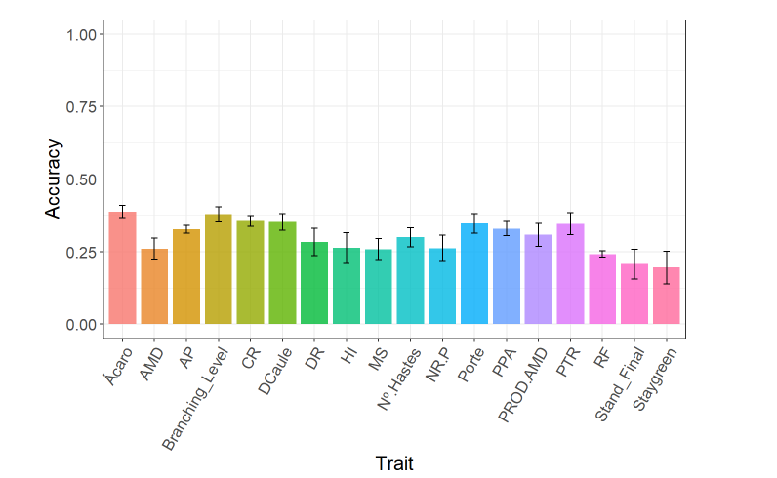
Figure 5 – Prediction accuracy (correlation between the GEBV and BLUPs) using cross-validation for traits evaluated

Slide 8
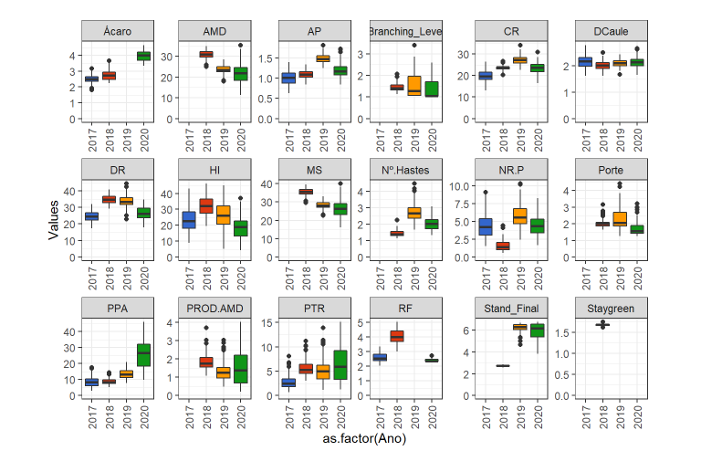
Figure 6 – Boxplot of the BLUPs by mixed models added to phenotypic means for traits evalueted by year.

Slide 9
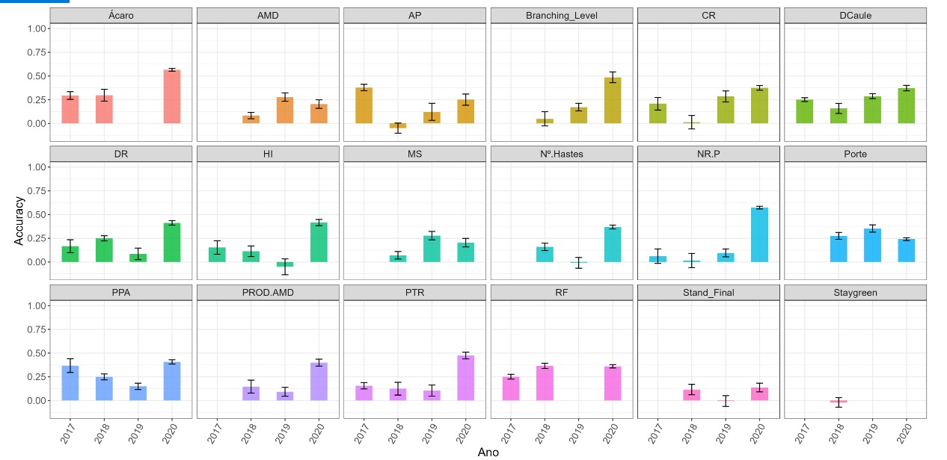
Figure 7 – Prediction accuracy (correlation between the GEBV and BLUPs) using cross-validation for traits evaluated by year

